Slide 1
MAINTENANCE ACTIVITY PHOTOS

Slide 2

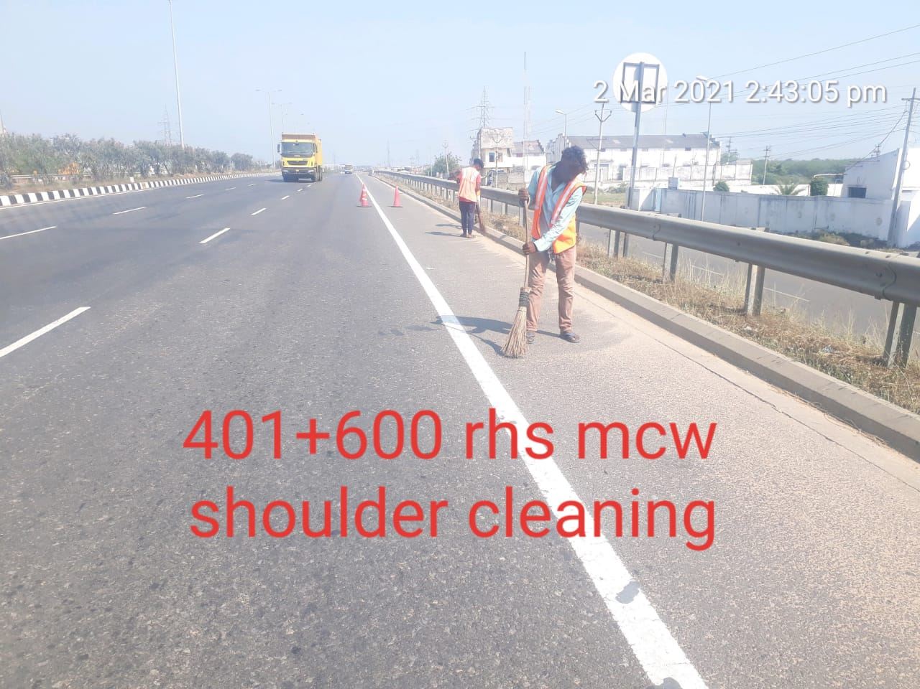
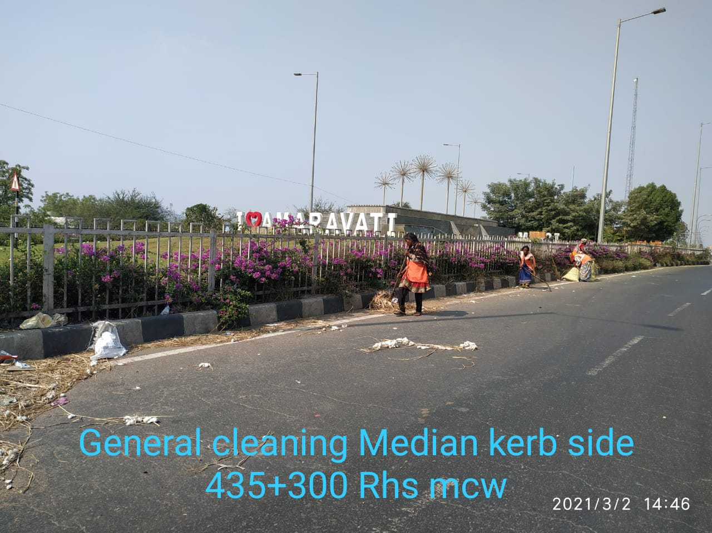
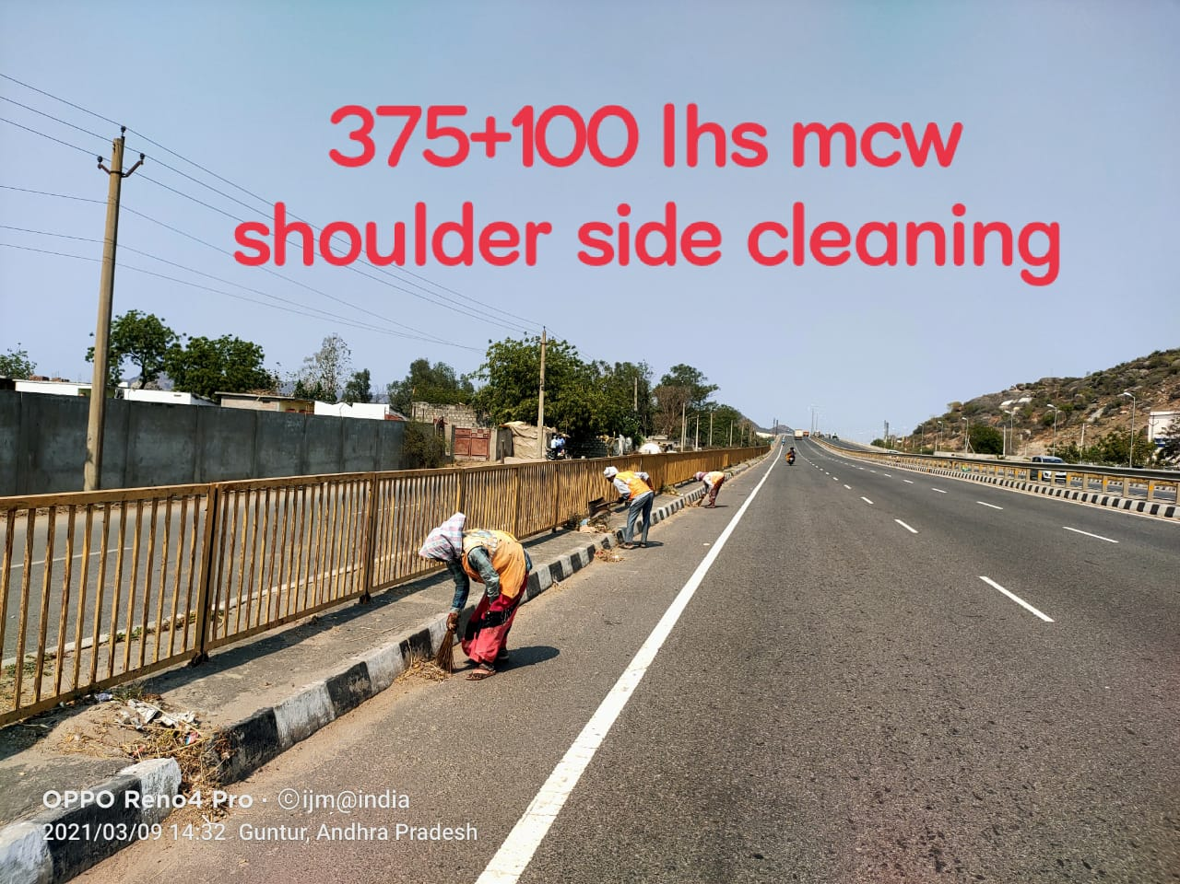
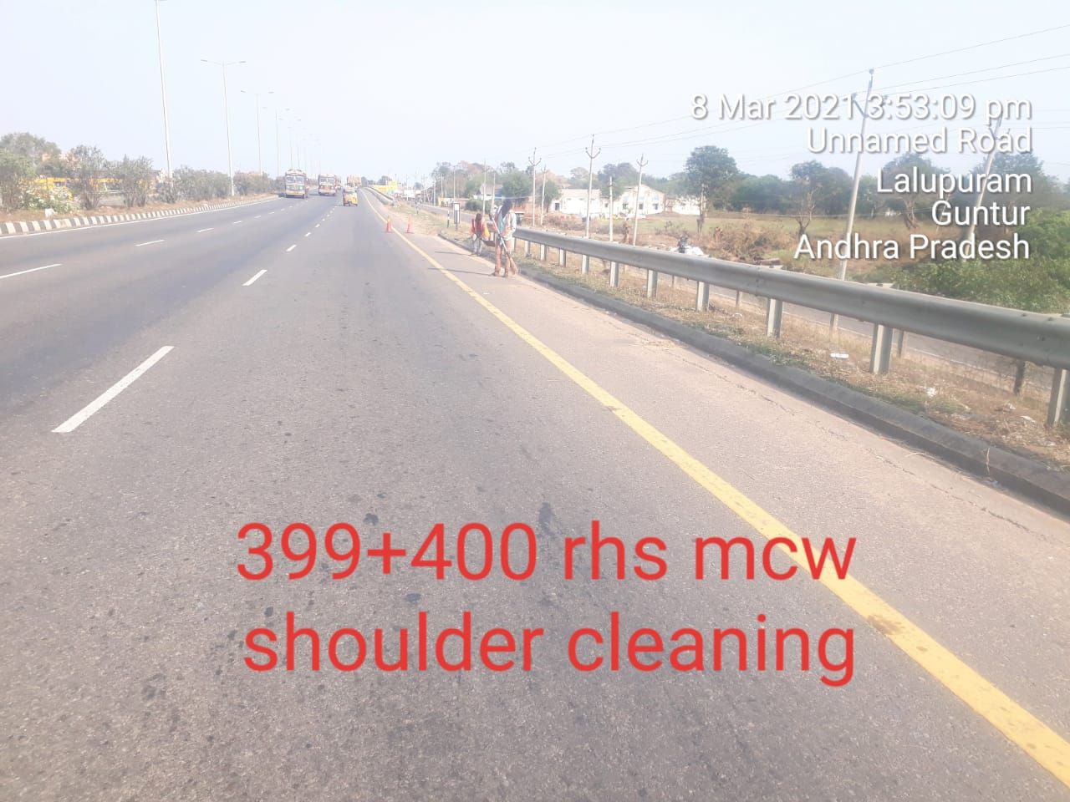
  GENERAL CLEANING AT MAIN CARRIAGE WAY

Slide 3
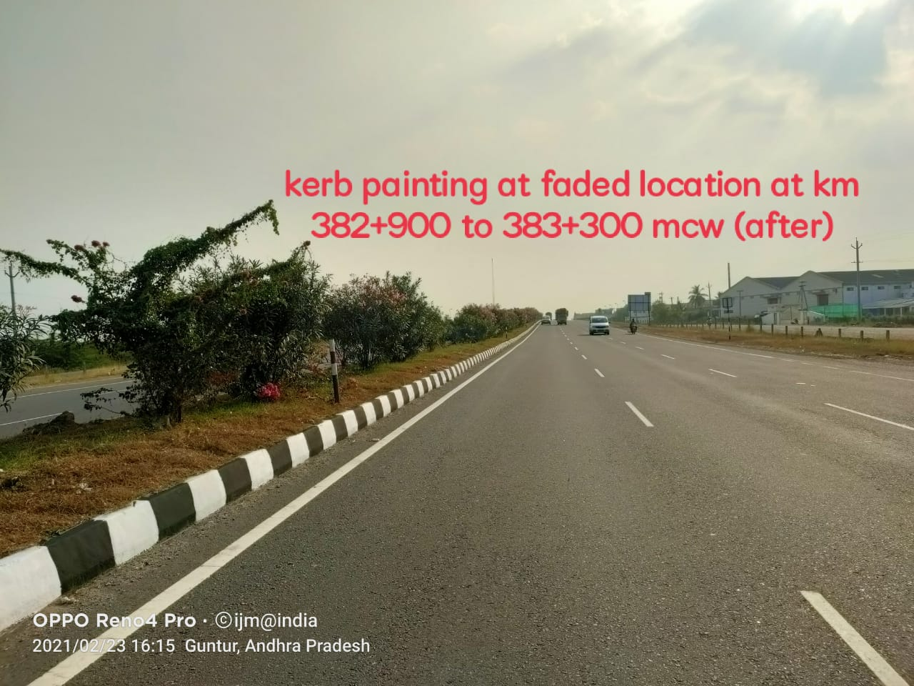
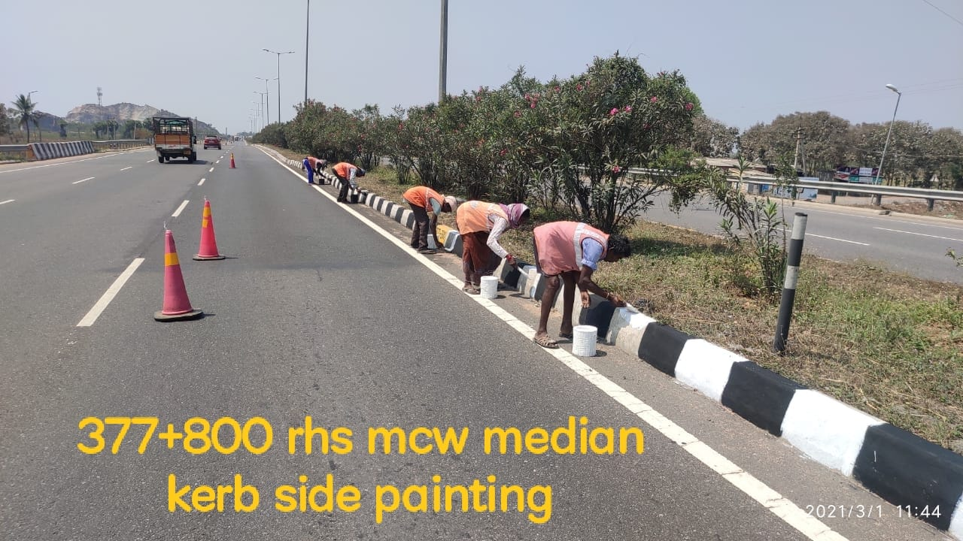
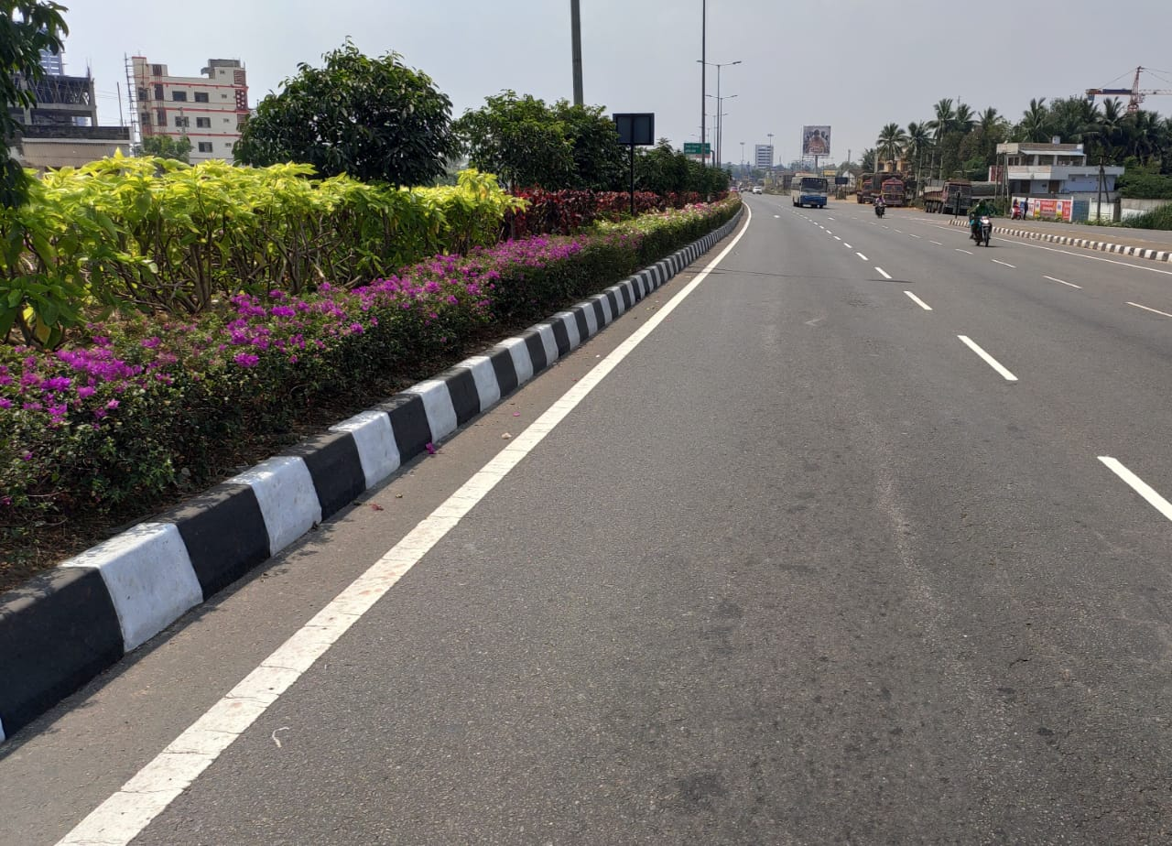
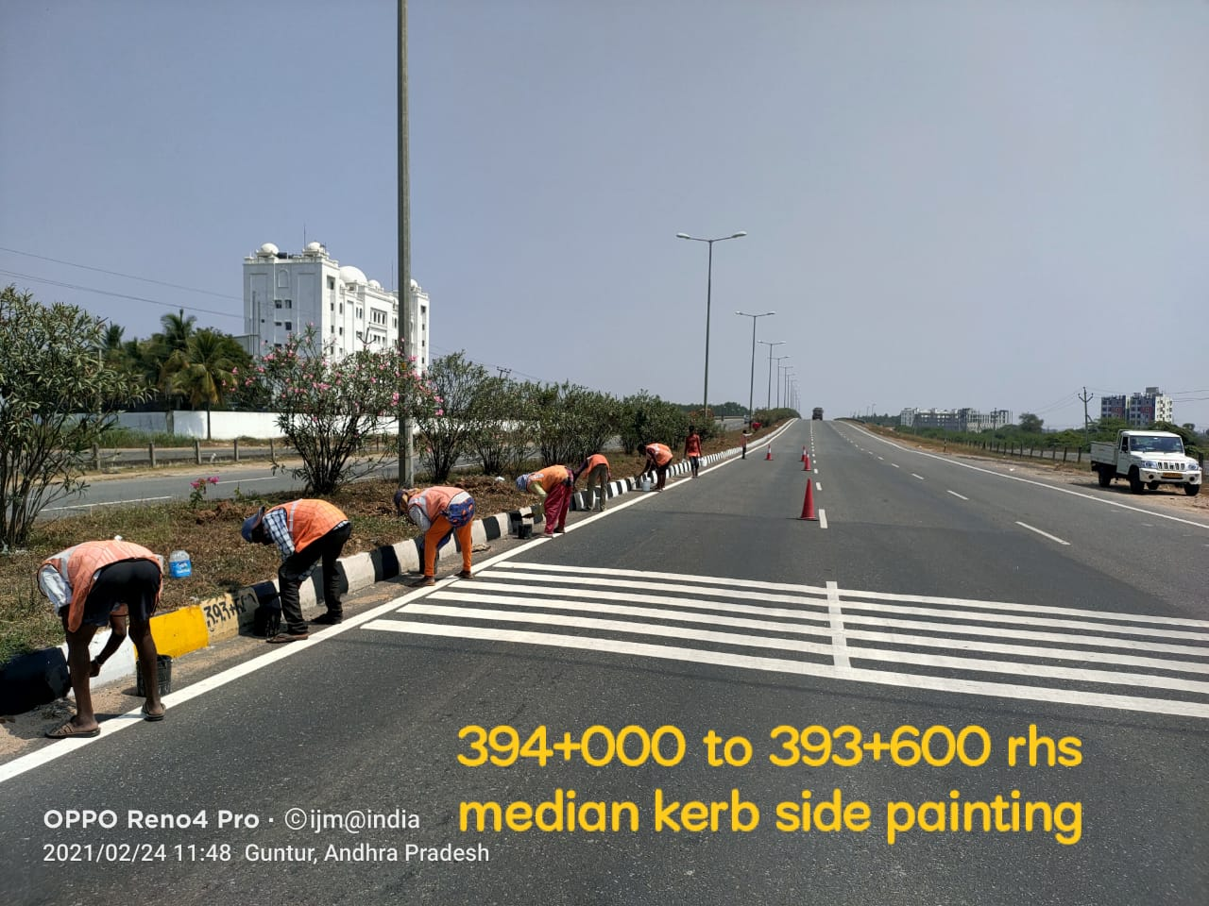
  KERB PAINTING AT FADED LOCATIONS

Slide 4
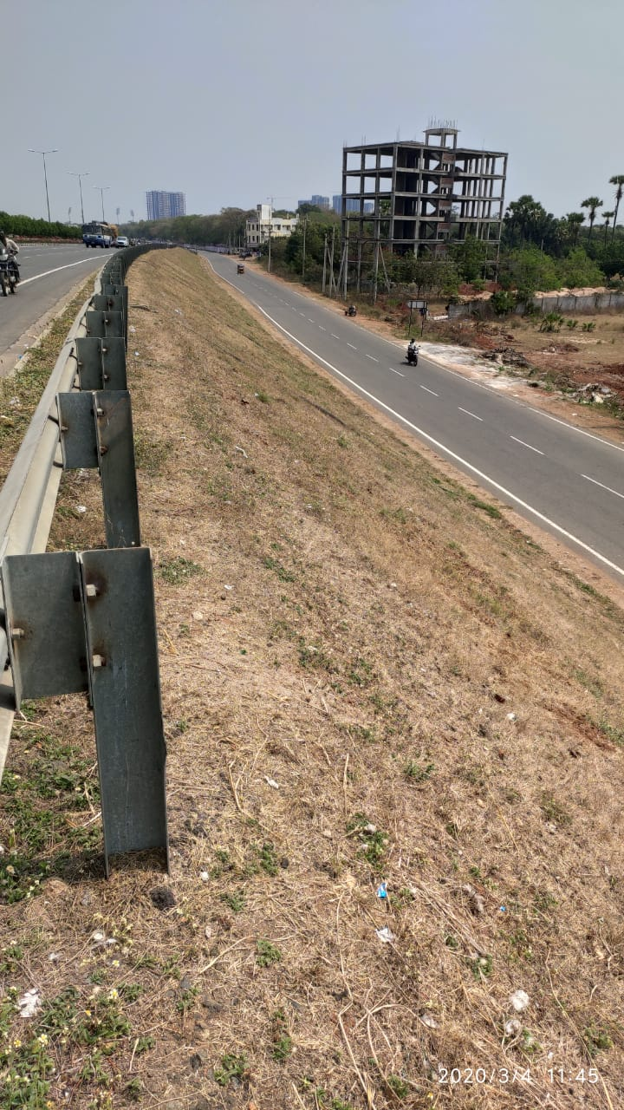
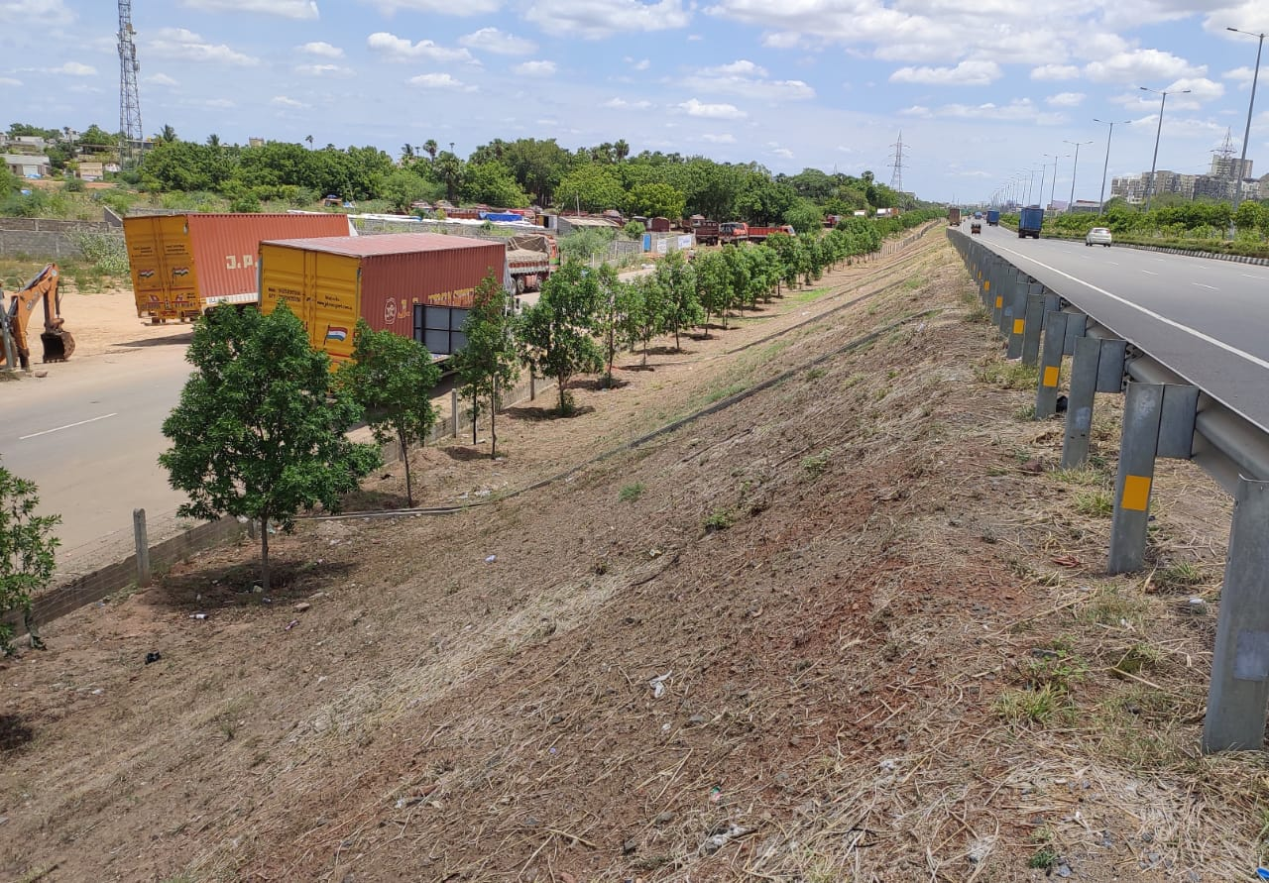
REMOVAL OF RANK VEGETATION

Slide 5
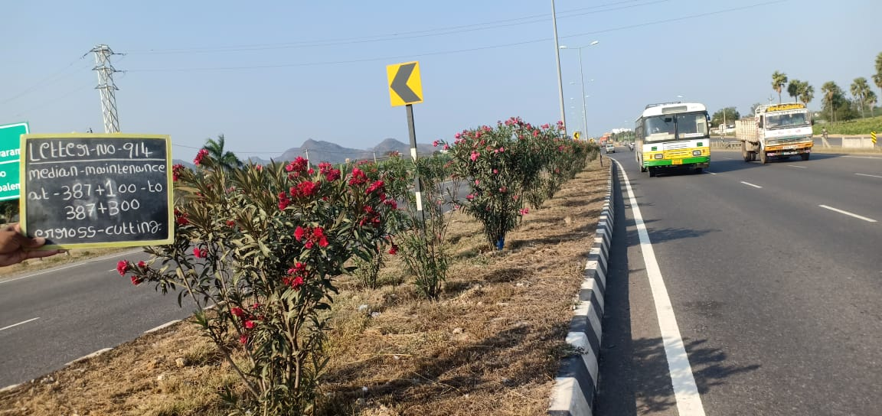
MEDIAN MAINTENANCE

Slide 6
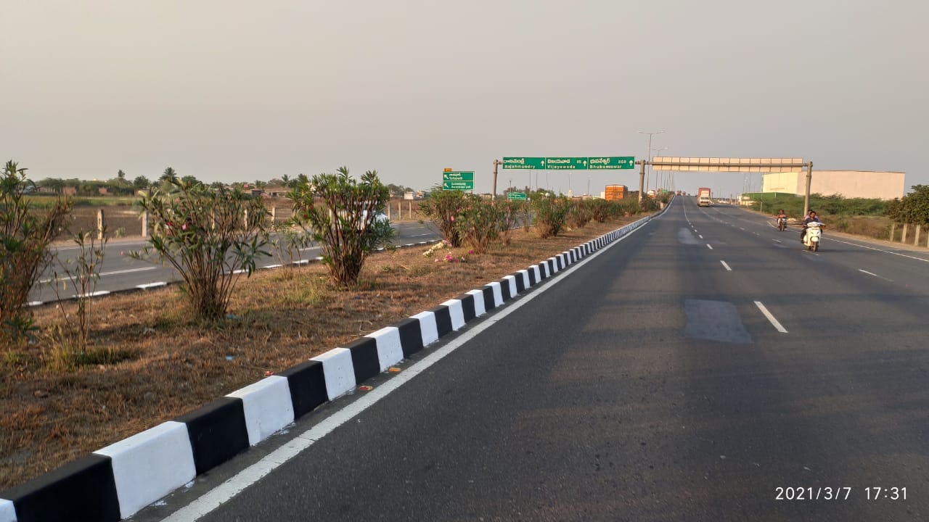
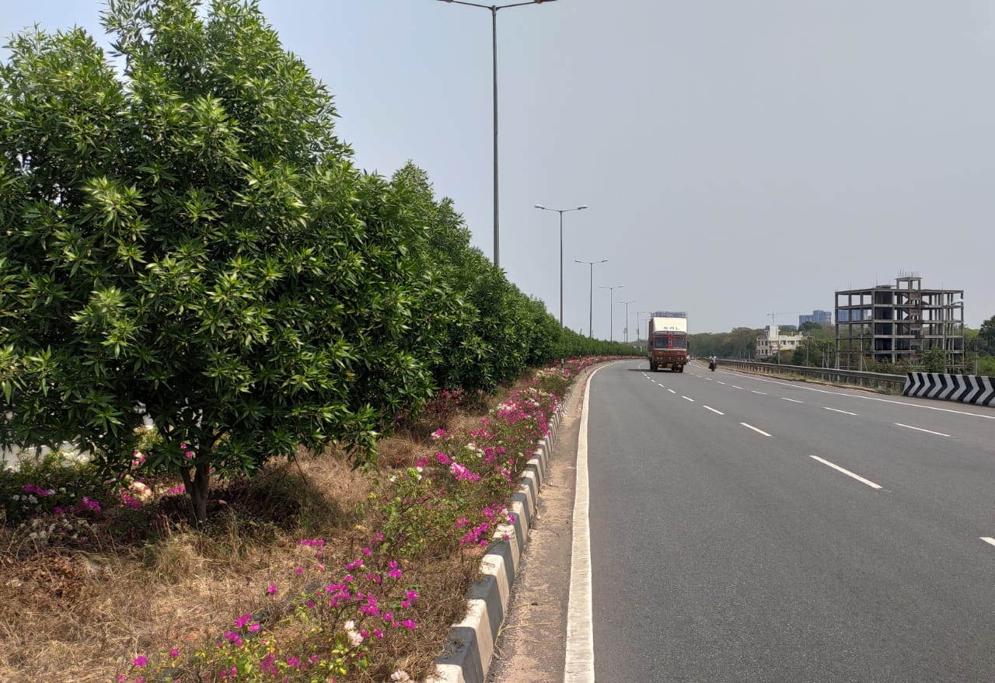
MEDIAN MAINTENANCE

Slide 7
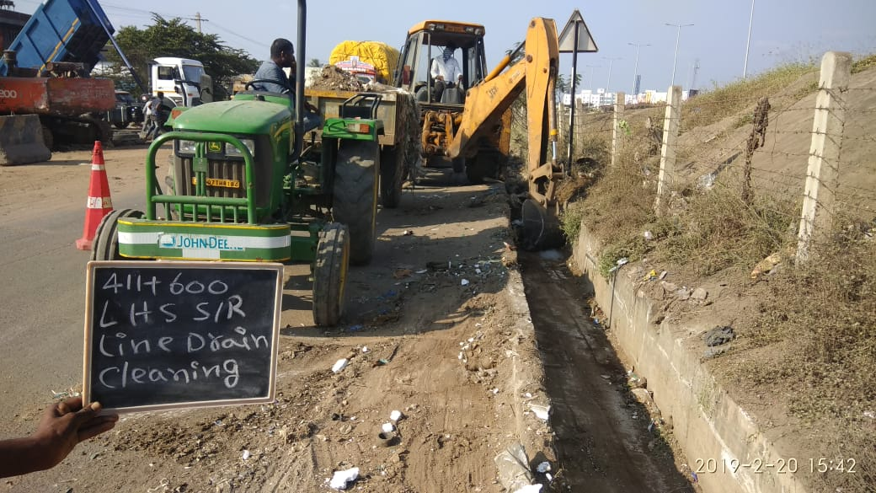
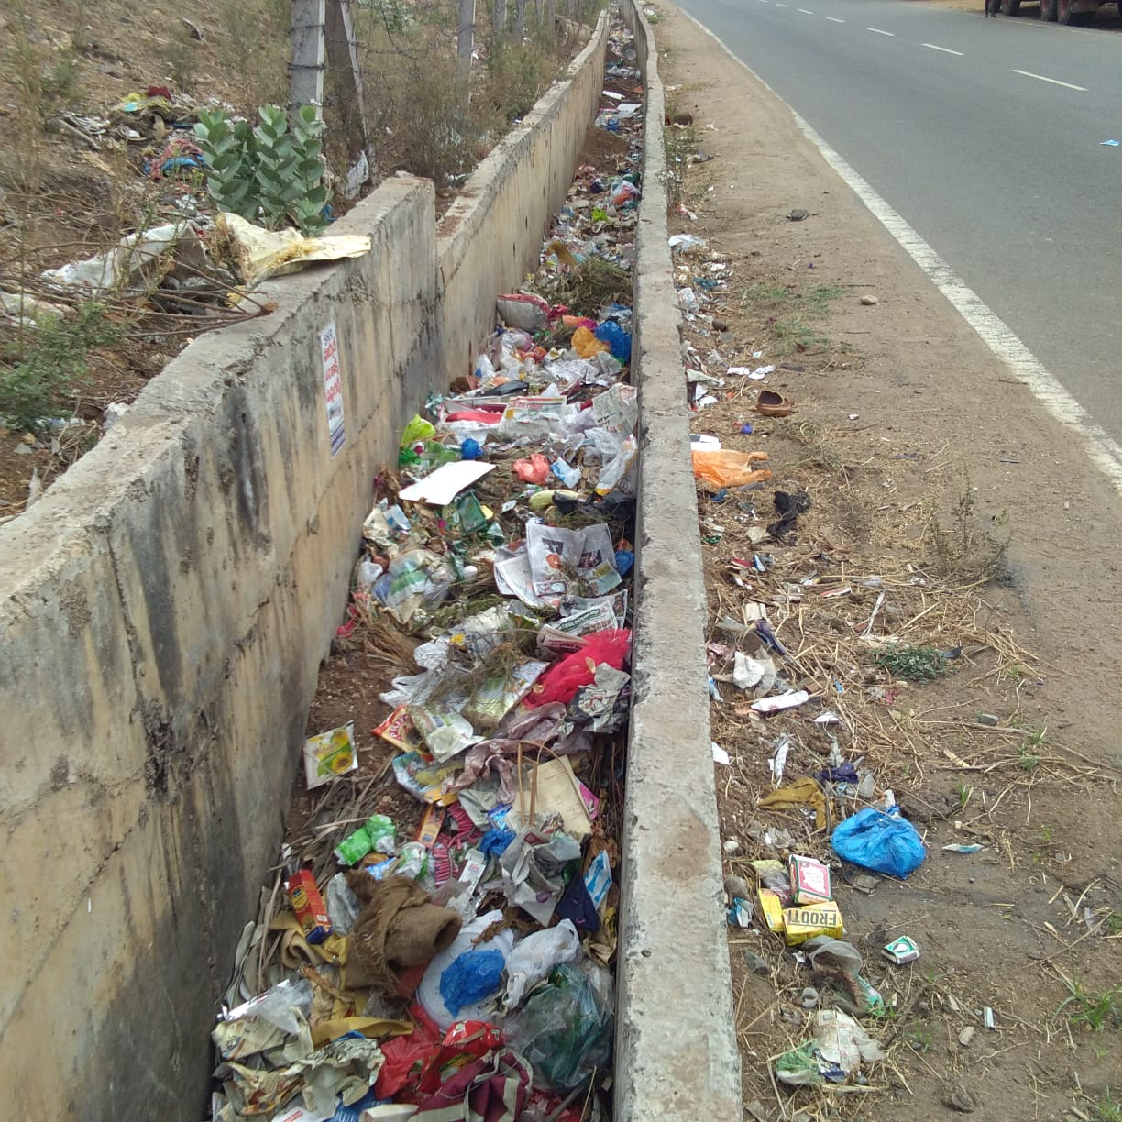
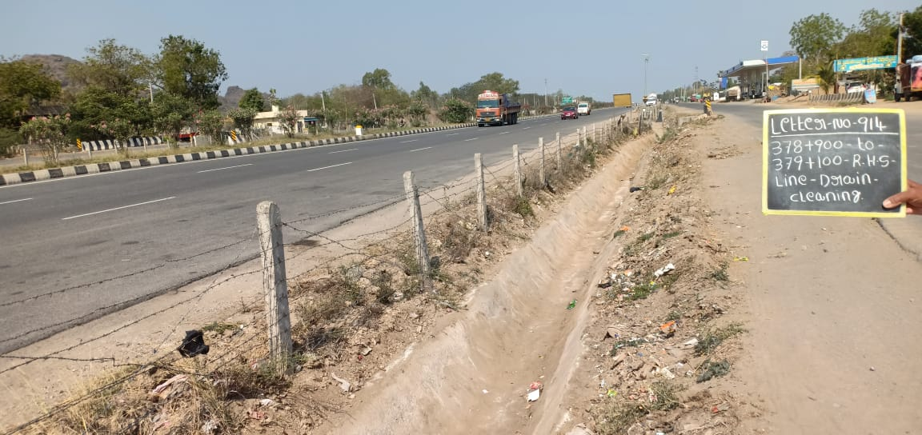
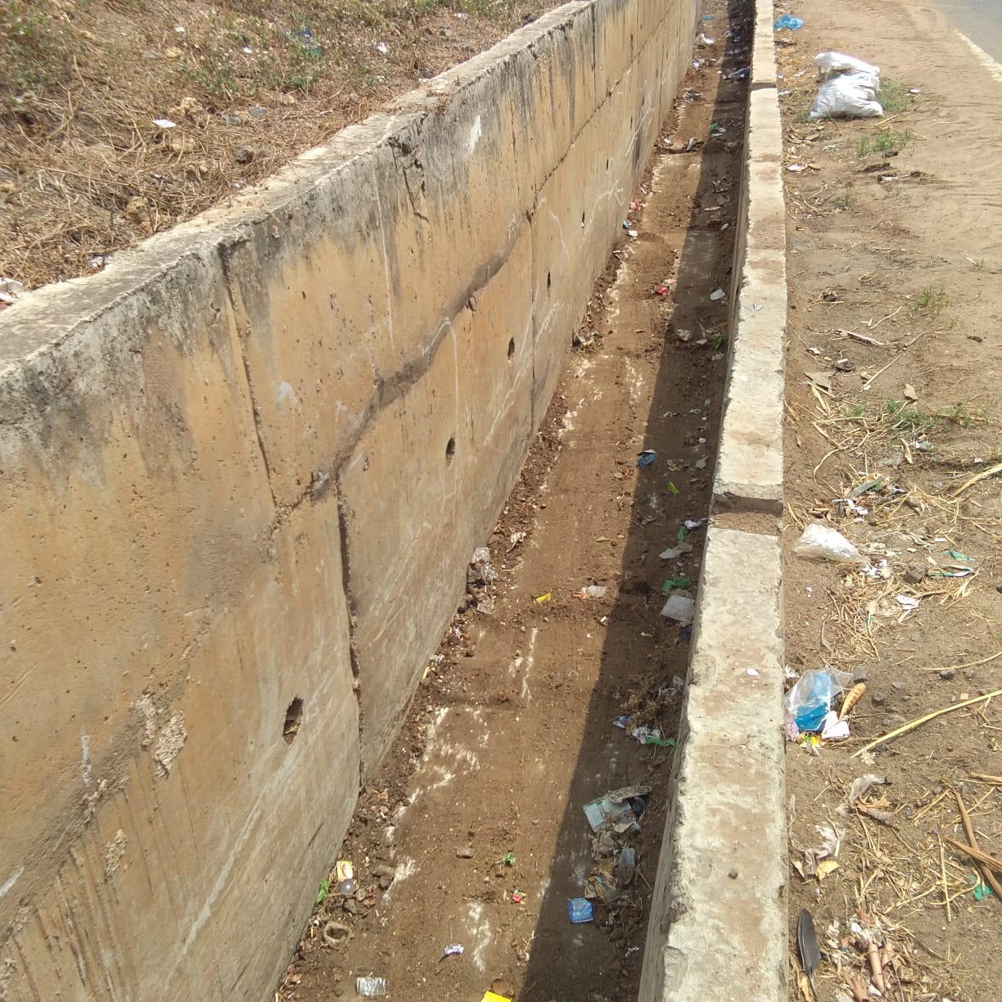
DRAIN CLEANING

Slide 8
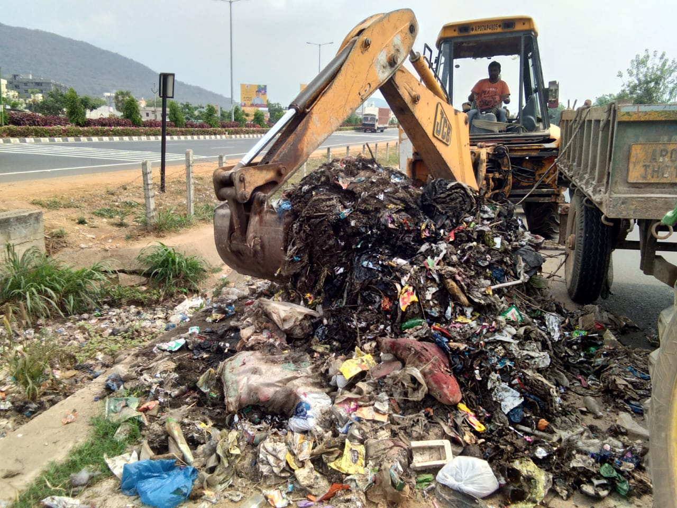
Garbage at Service road Shoulder

Slide 9
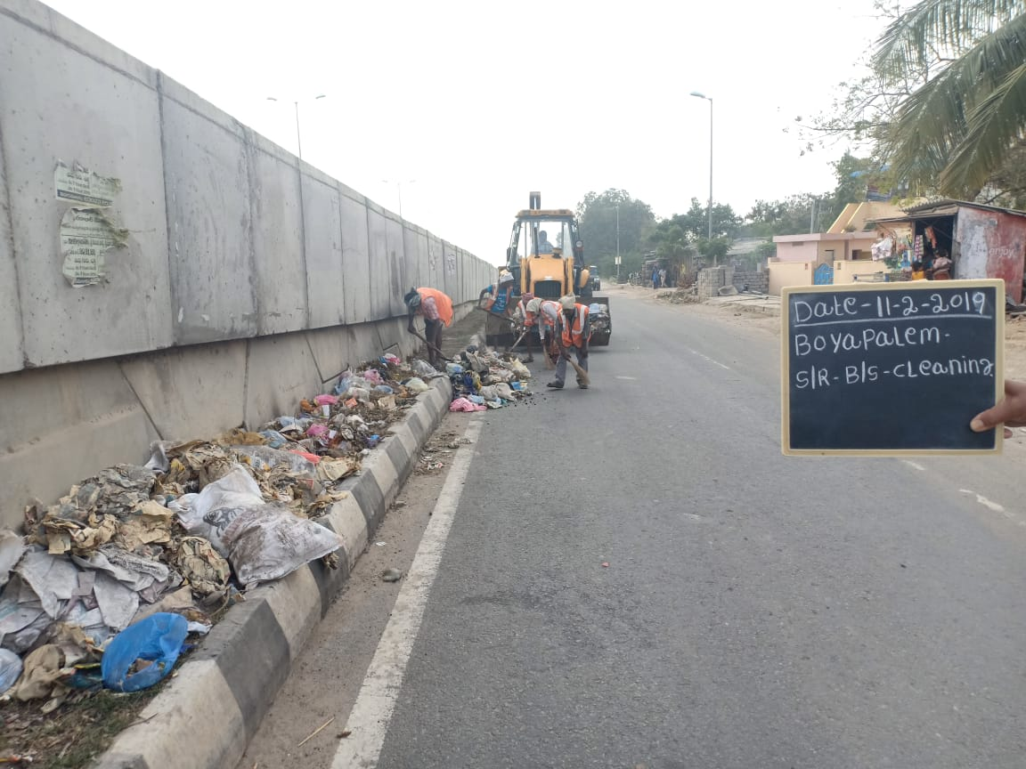
Garbage at Service road Shoulder

Slide 10
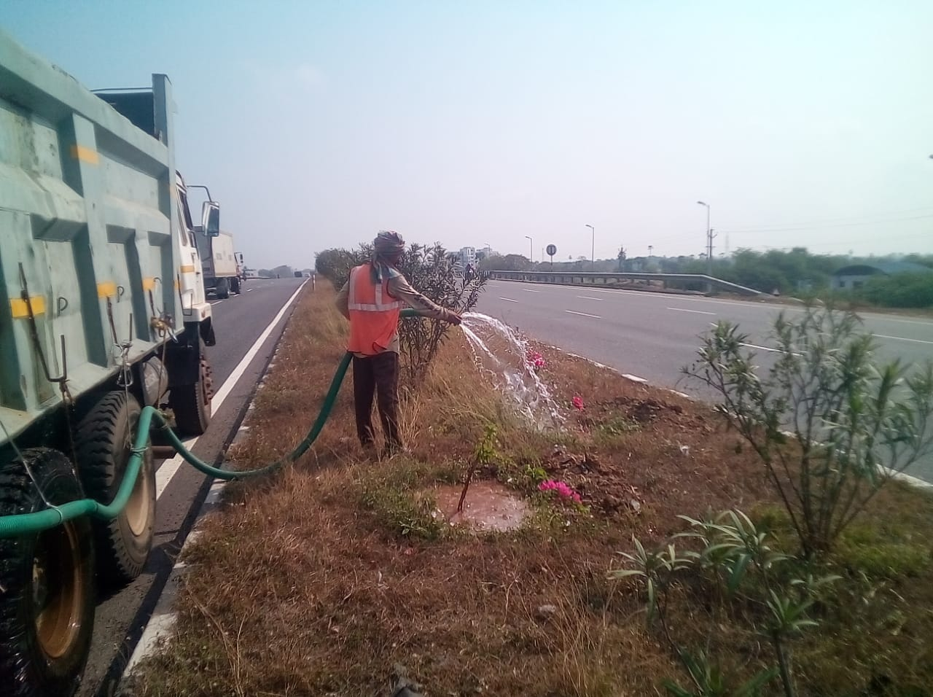
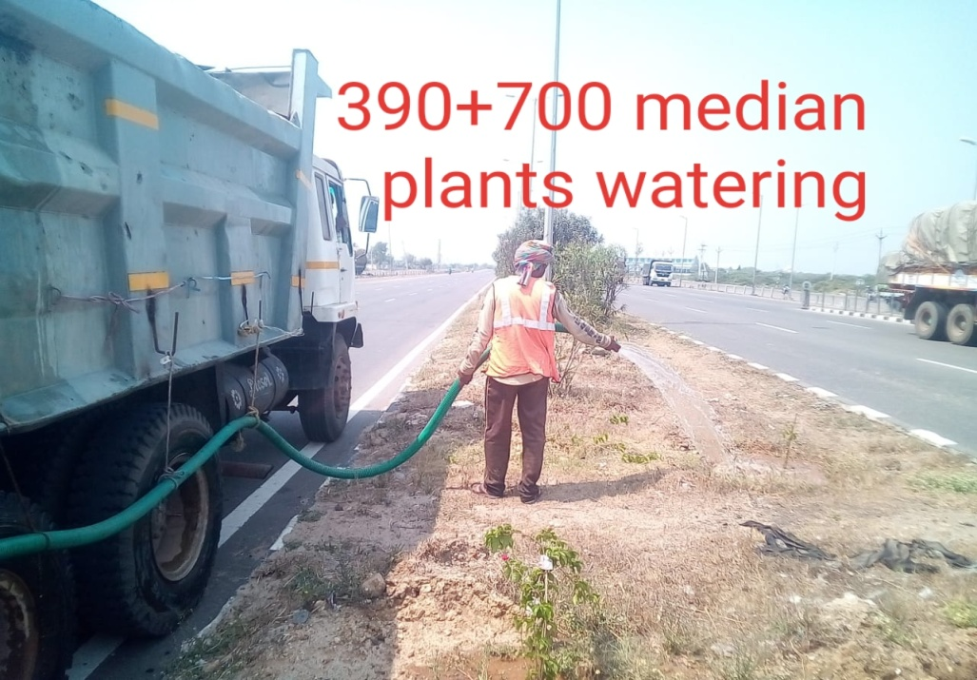
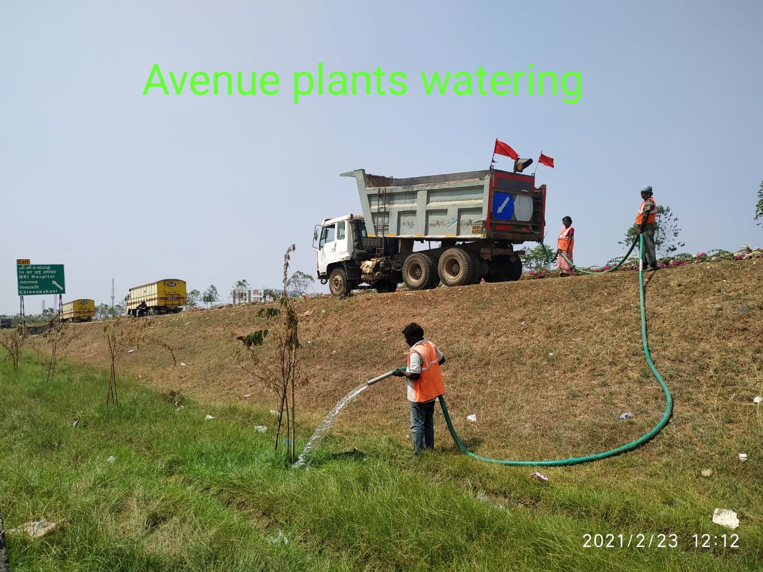
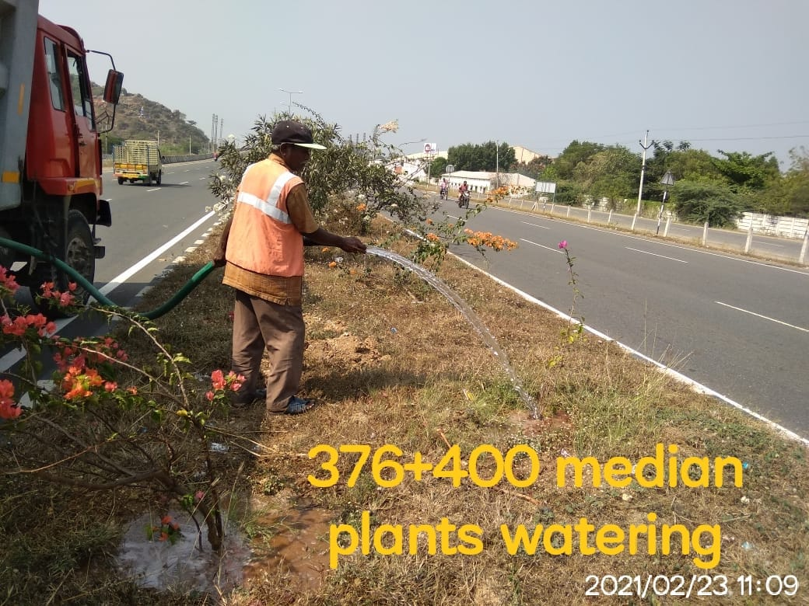
MEDIAN PLANTS WATERING

Slide 11
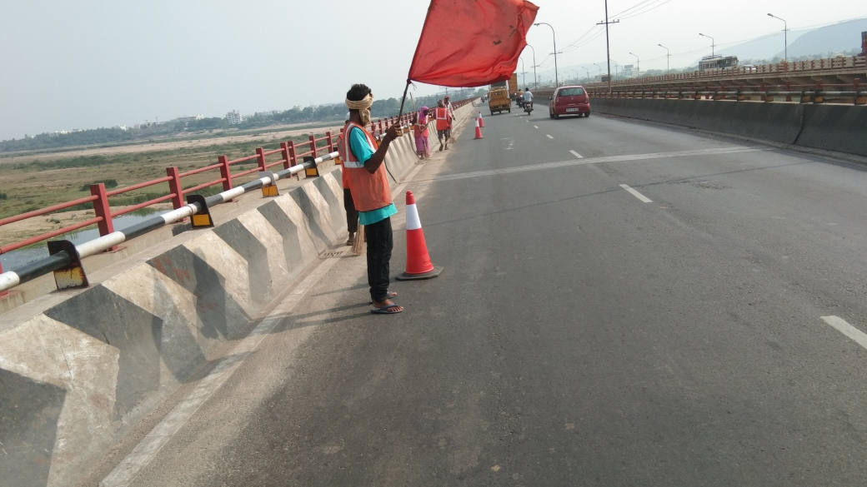
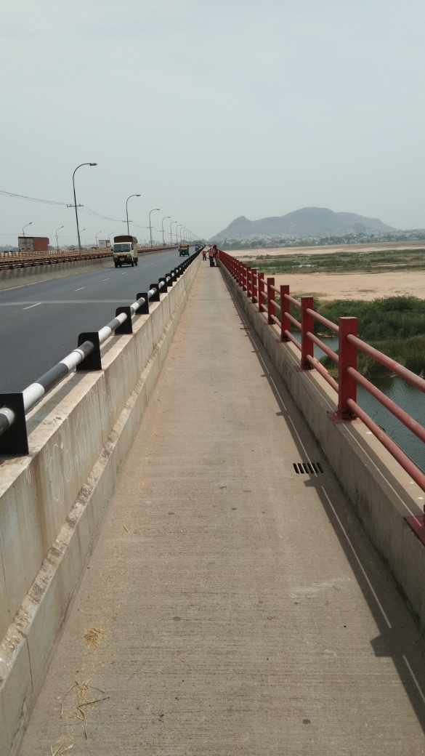
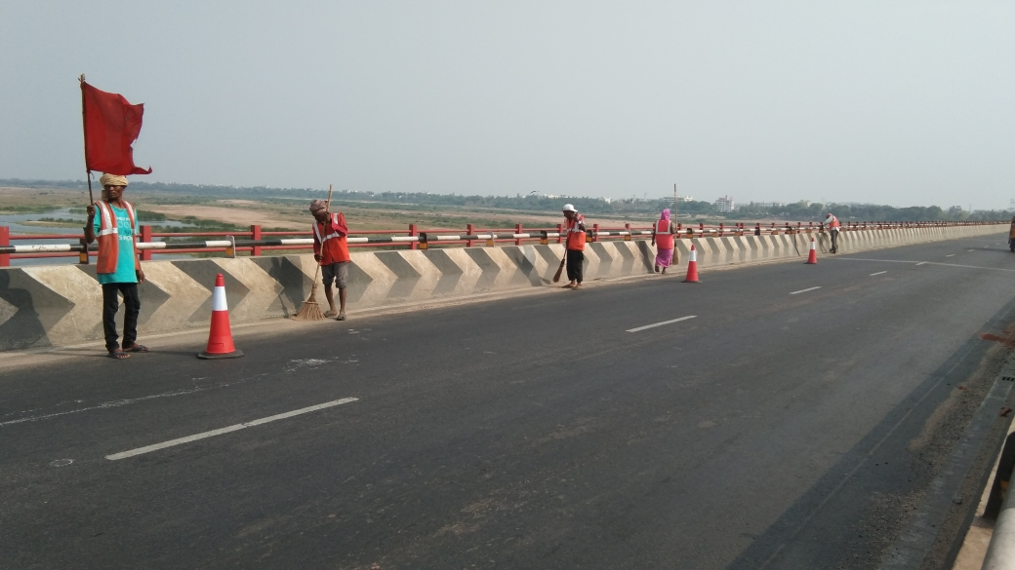
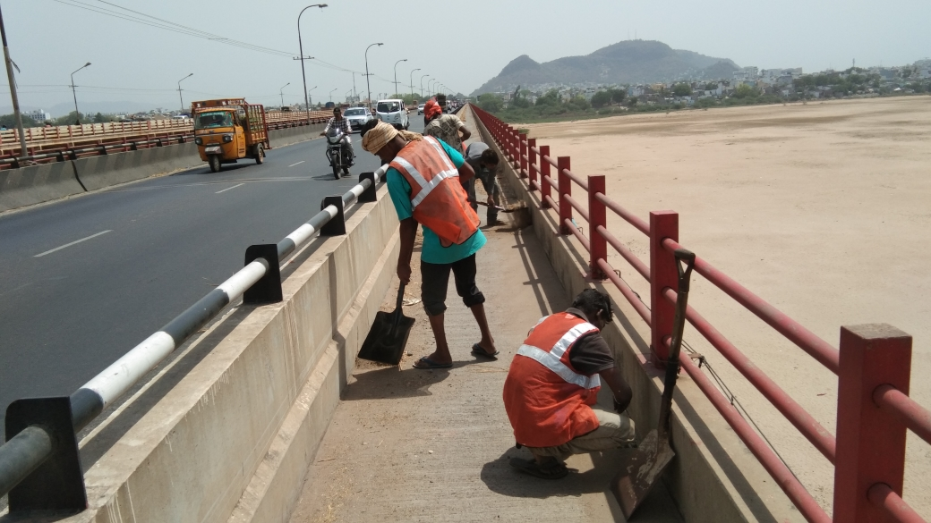
KRISHNA BRIDGE GENERAL CLEANING WORKS

Slide 12
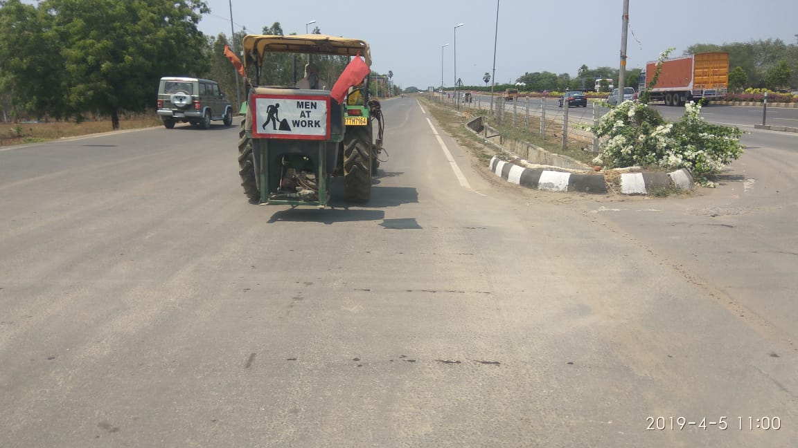
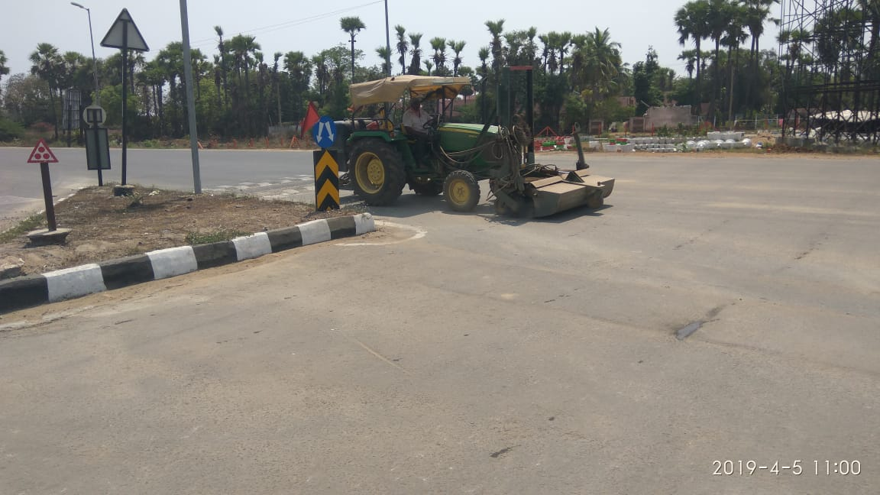
GENERAL CLEANING WITH BROOMER

Slide 13
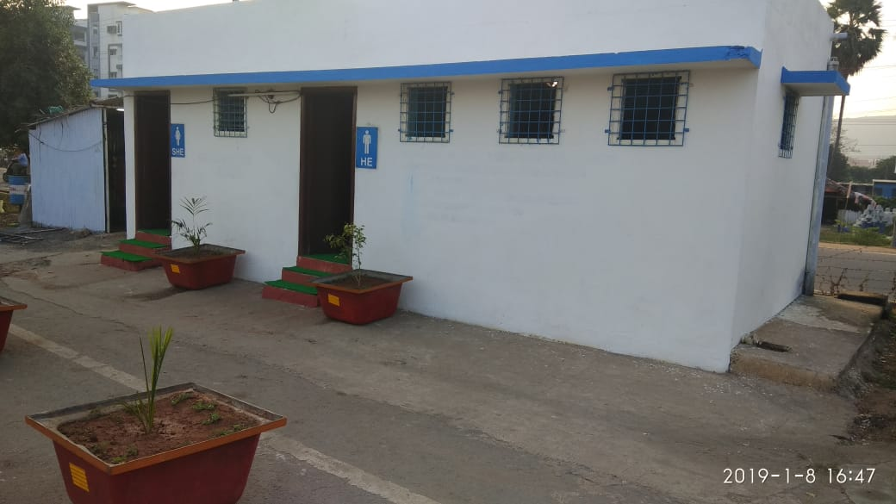
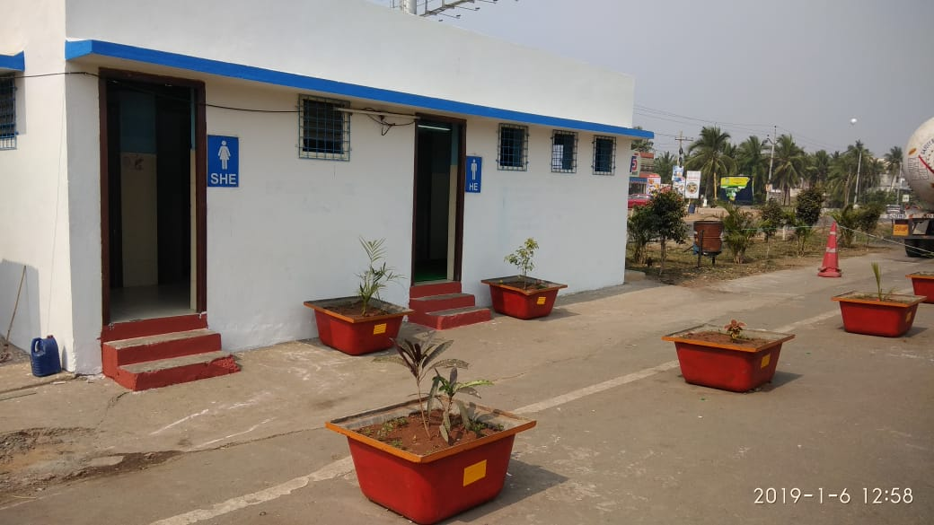
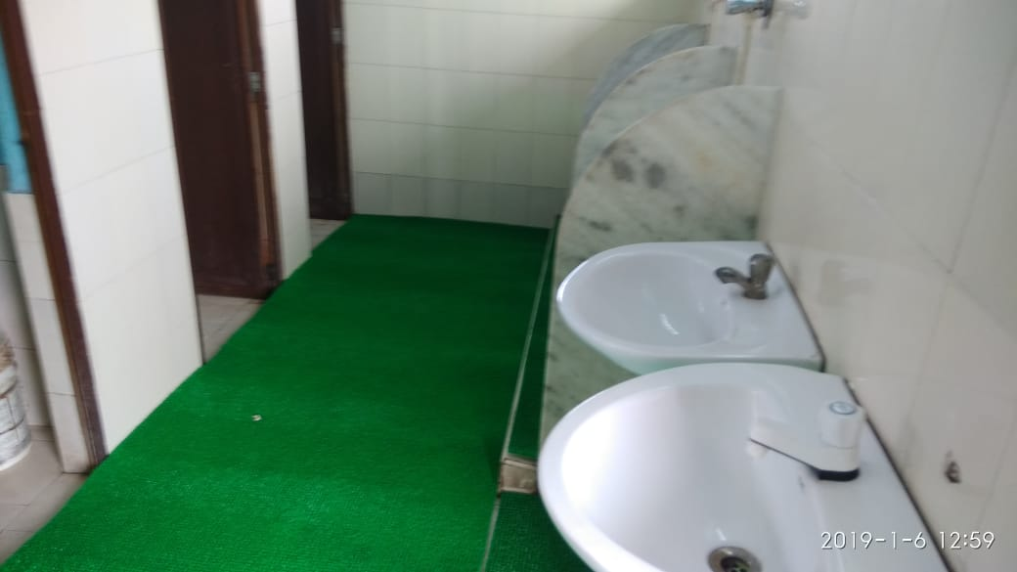
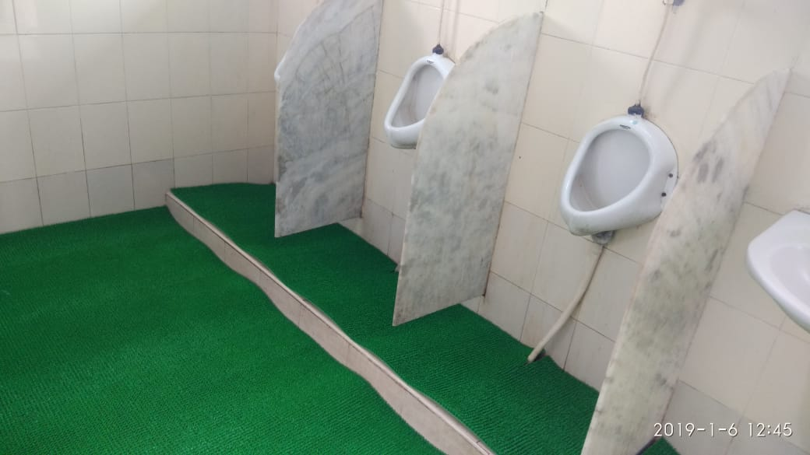
TOILETS MAINTENANCE AT TRUCK LAYBAY LOCATIONS

Slide 14
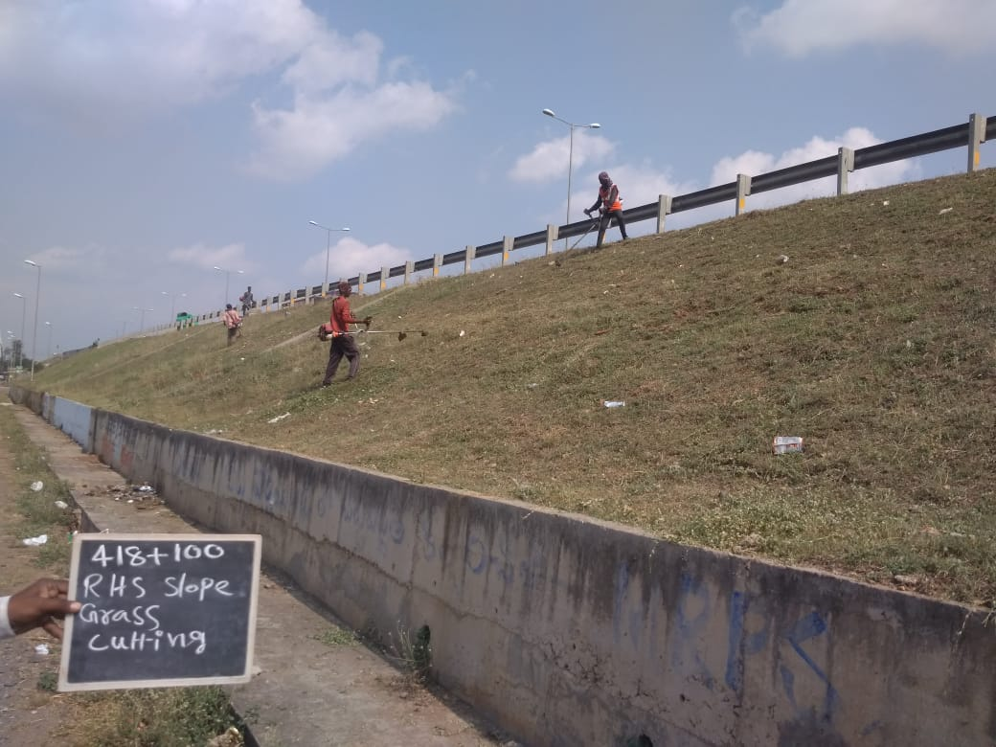
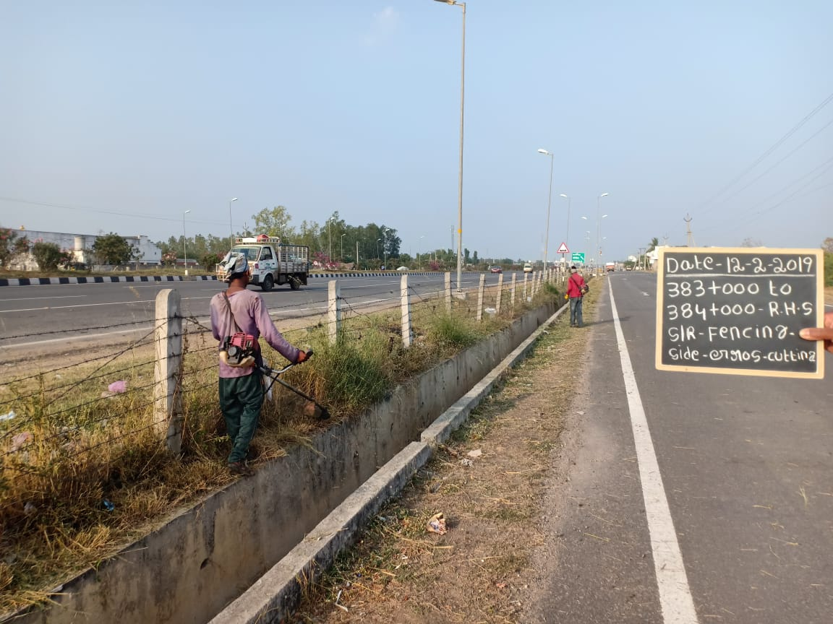
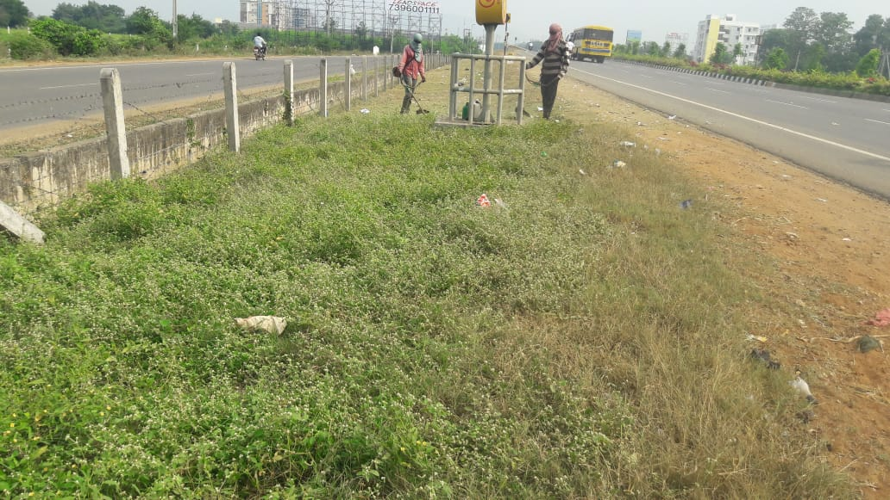
GRASS CUTTING AT MCW SLOPES

Slide 15
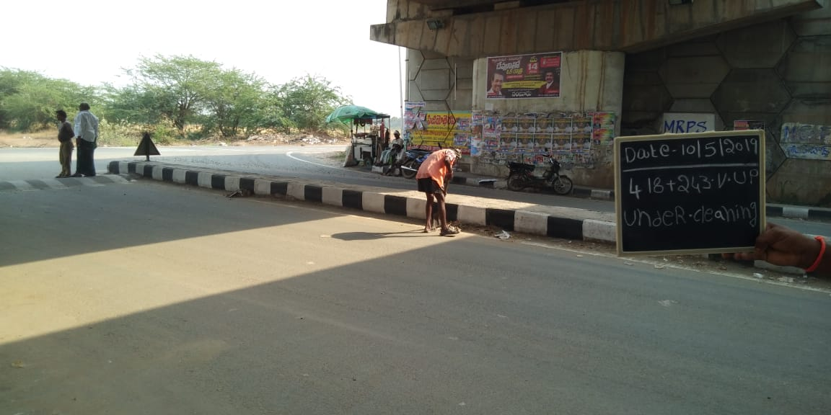
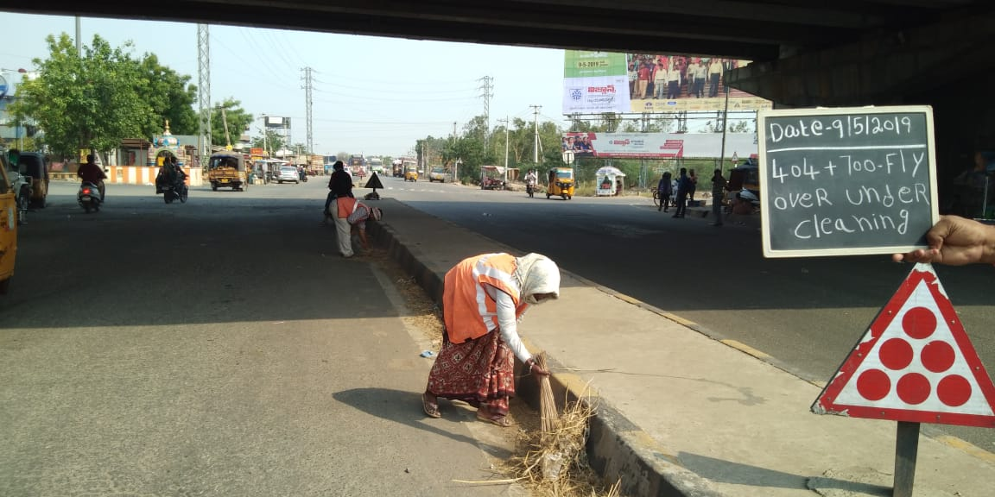
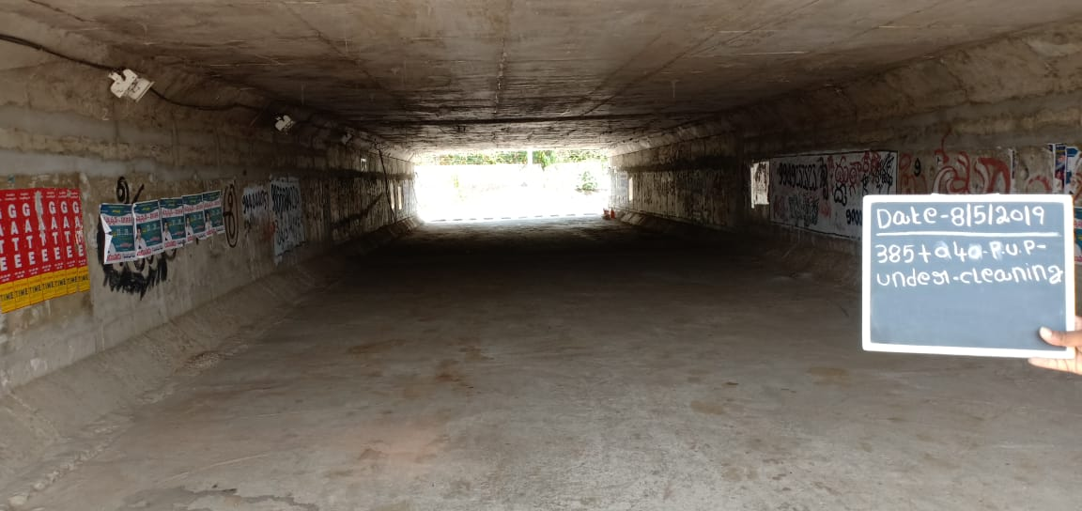
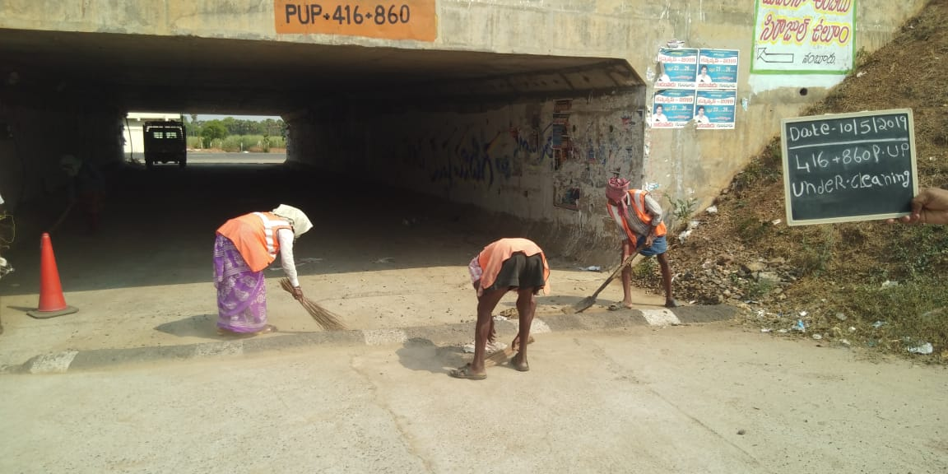
PUP / VUP CLEANING WORKS

Slide 16
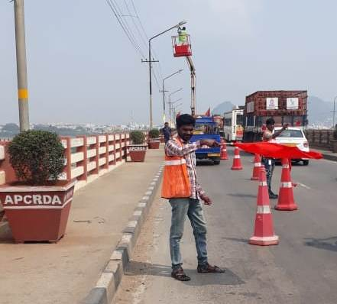
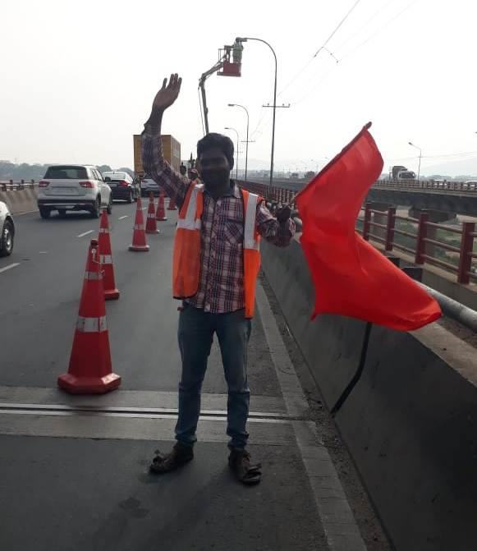
HIGHWAY LIGHTS REPAIRING

Slide 17
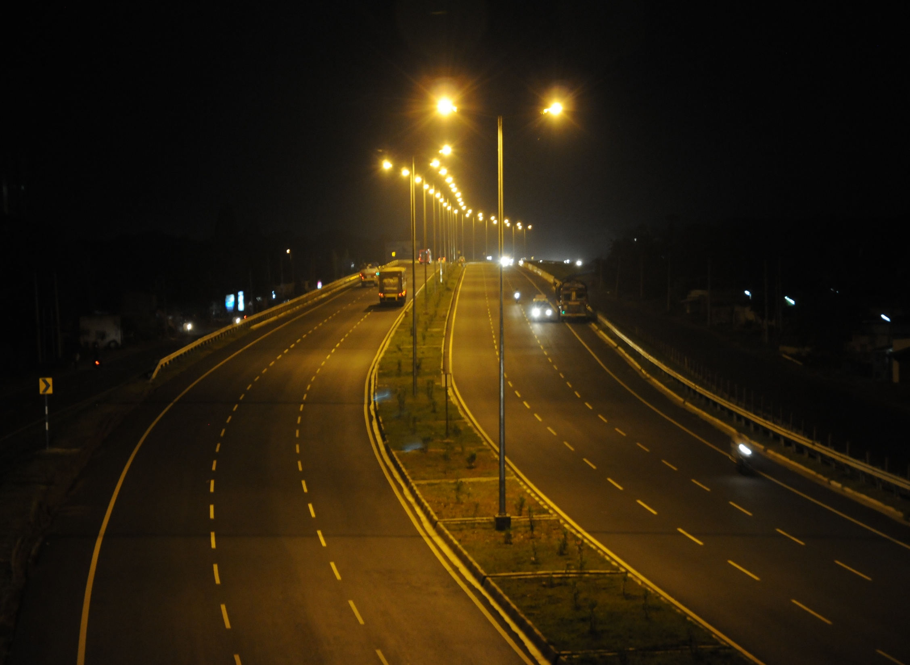
HIGHWAY LIGHTS (Night View)

Slide 18
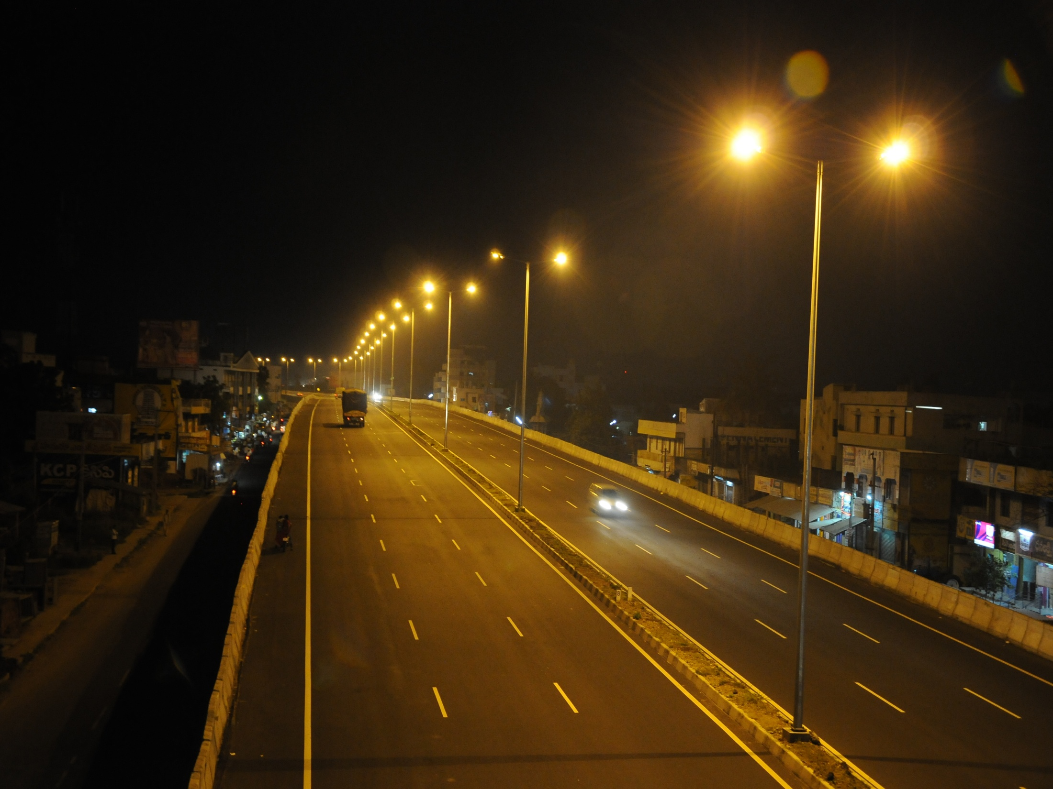
HIGHWAY LIGHTS (Night View)

Slide 19
RECTIFICATION ACTIVITY PHOTOS

Slide 20
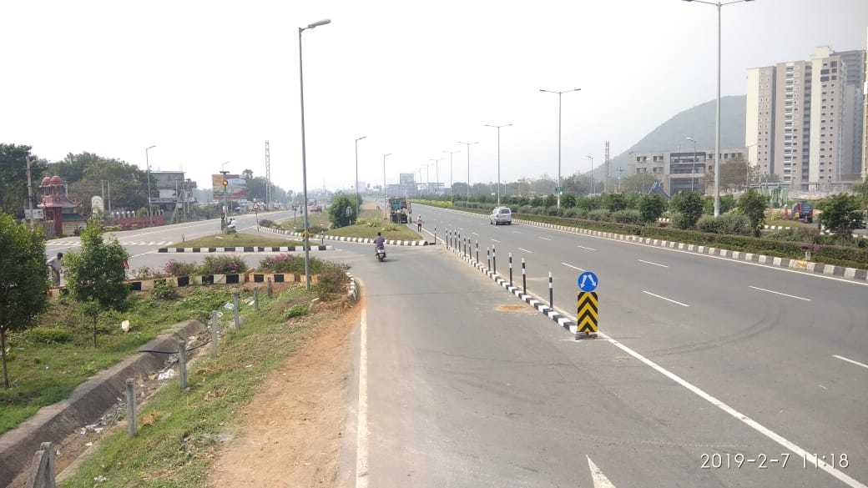
RECTIFICATION OF NON MOUNTABLE KERBS AT ENTRY/EXIT RAMPS

Slide 21
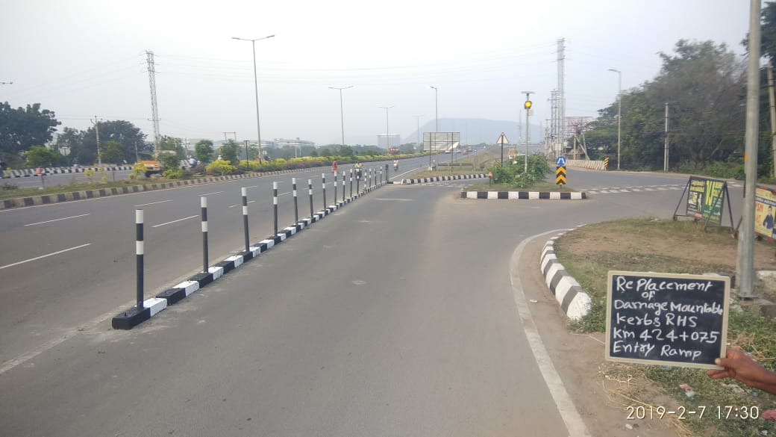
RECTIFICATION OF NON MOUNTABLE KERBS AT ENTRY/EXIT RAMPS

Slide 22
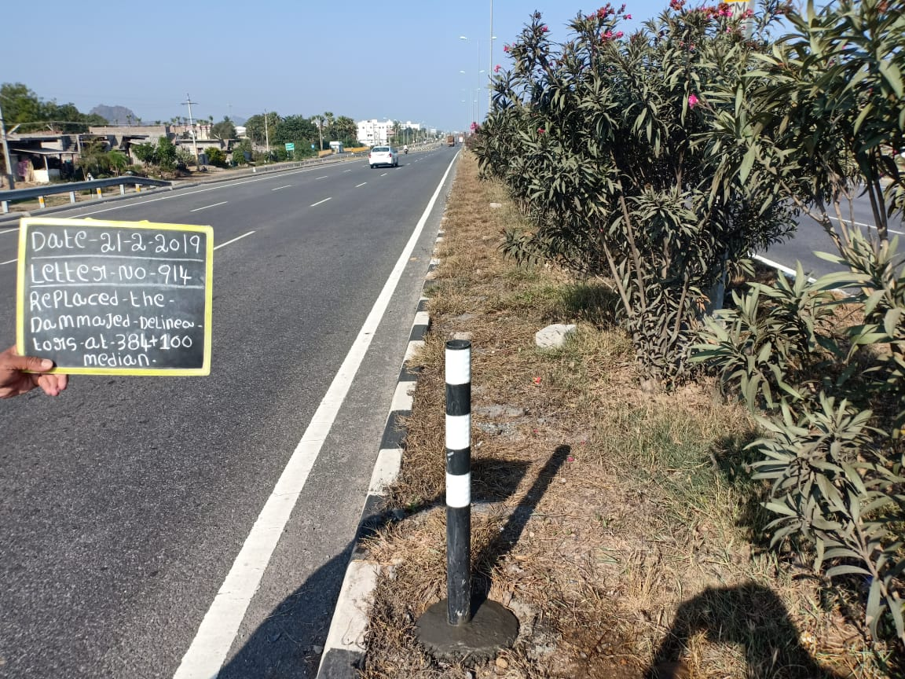
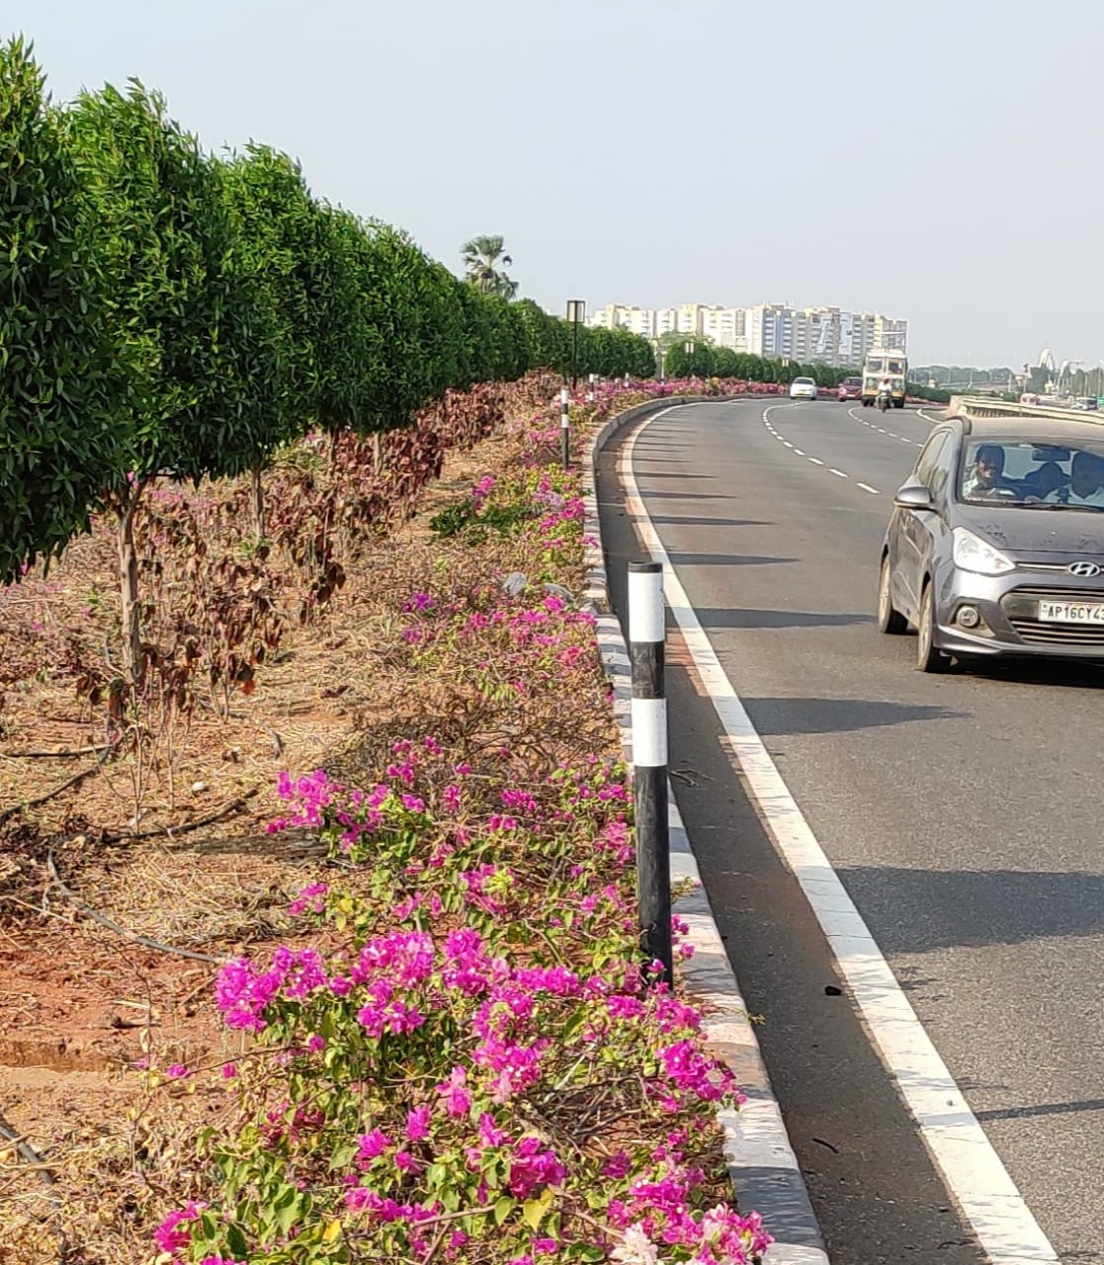
REPLACEMENT OF DAMAGED DELINEATORS

Slide 23
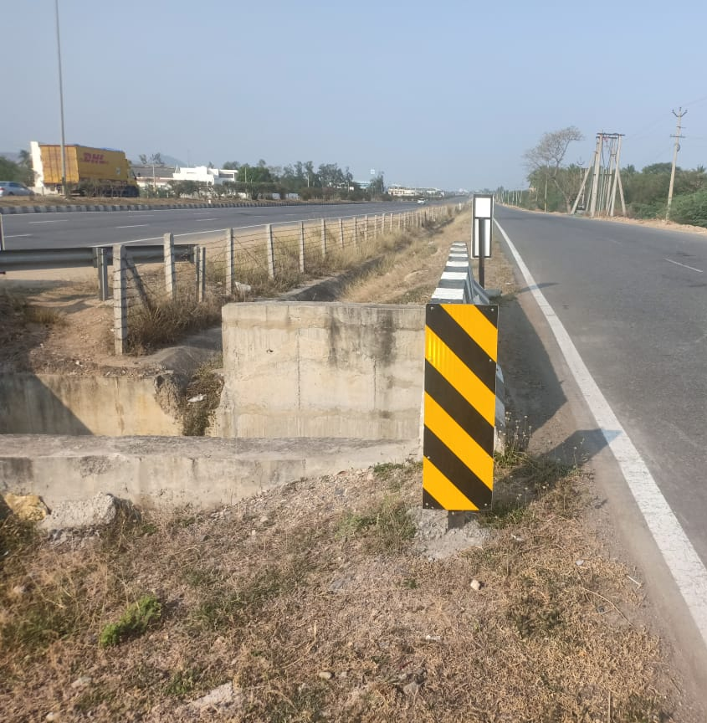
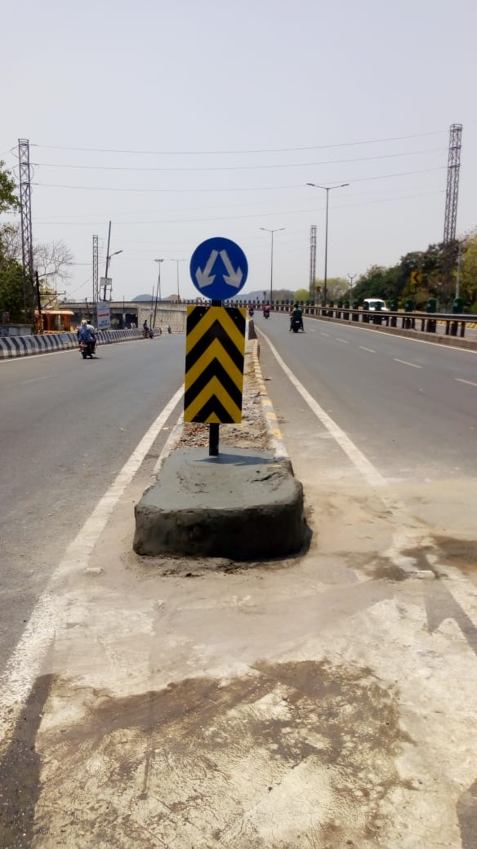
REPLACEMENT OF DAMAGED MARKER SIGN BOARDS

Slide 24



RECTIFICATION OF DAMAGED SHOULDERS AT MCW

Slide 25




RECTIFICATION OF DAMAGED FENCING POLES

Slide 26




RECTIFICATION OF DAMAGED ELECTRICAL POLES

Slide 27




REPLACEMENT OF DAMAGED SIGN BORADS

Slide 28




RECTIFICATION OF OVERLAY PATCH WORKS

Slide 29




RECTIFICATION OF DAMAGED RAILING WORKS AT KRISHNA BRIDGE

Slide 30


Replacement of damaged 5kilometre & 1kilometre stone

Slide 31
OTHER PHOTOS

Slide 32

Six-Laning of Chilkaluripet-Vijayawada Section of NH-5 BOT (TOLL) On DBFO Pattern Under NHDP Phase-V

Slide 33

Presentation for VRP Routine Maintenance
& Overlaying Works
Option-2
Six-Laning of Chilkaluripet-Vijayawada Section of NH-5 BOT (TOLL) On DBFO Pattern Under NHDP Phase-V

Slide 34

Six-Laning of Chilkaluripet-Vijayawada Section of NH-5 BOT (TOLL) On DBFO Pattern Under NHDP Phase-V

Slide 35

Six-Laning of Chilkaluripet-Vijayawada Section of NH-5 BOT (TOLL) On DBFO Pattern Under NHDP Phase-V

Slide 36

Six-Laning of Chilkaluripet-Vijayawada Section of NH-5 BOT (TOLL) On DBFO Pattern Under NHDP Phase-V

